Slide 1
Interfacing Push buttons to 8051 Development kit using Polling
Engr.Shahzada Fahim Jan

Slide 2
Polling
The microcontroller continuously monitors of status of a given device
When the condition met it perform the services
After that, it moves on to monitor the status of next device until every one is serviced
Monitor several devices and serve each of them when certain condition met
It is not efficient method
Wastes much of the microcontroller’s time

Slide 3
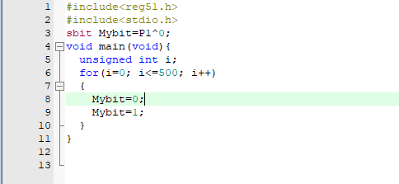
Sbit(single bit)
Widely used 8051 C data type
Used to access single-bit addressable registers.

Slide 4
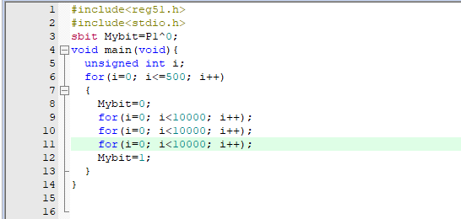

Slide 5
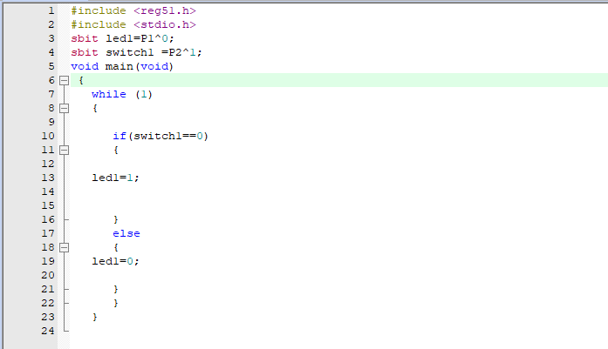
Polling

Slide 6
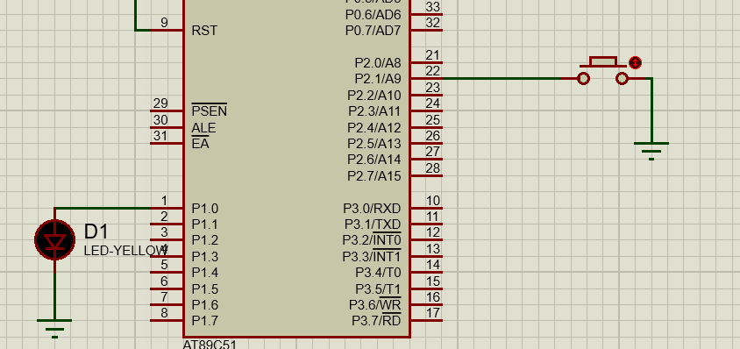

Slide 7
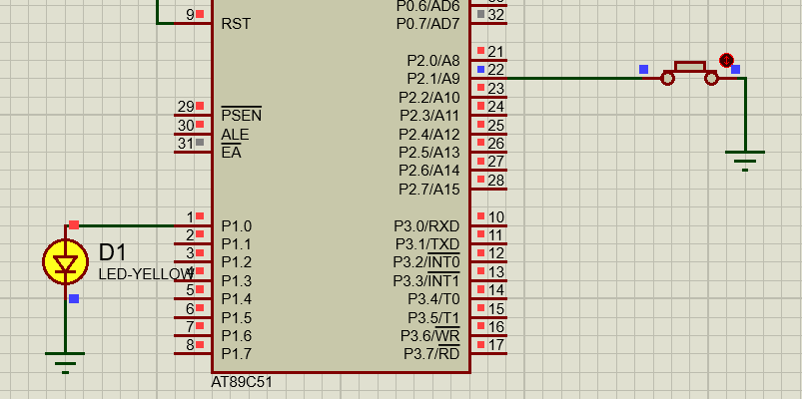

Slide 8
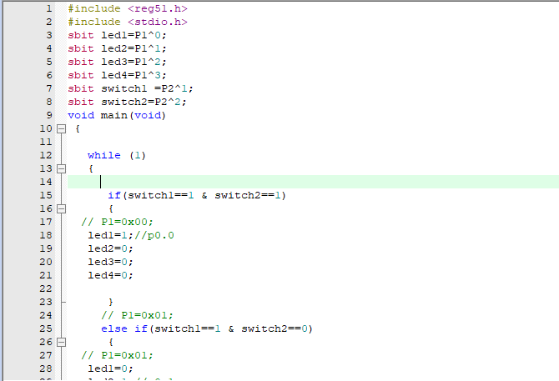

Slide 9
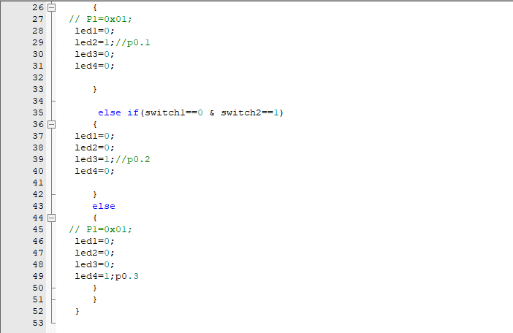

Slide 10
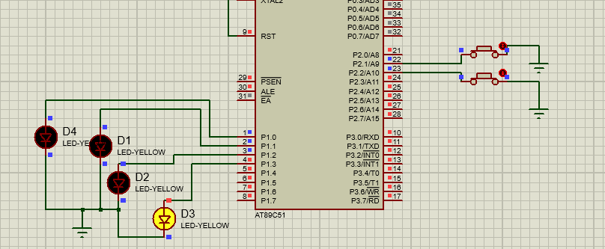

Slide 11
Tasks:
1) Complete all the tasks given in the slides
2) Attach 3 push button with PORT2 and 8 LED’s with PORT1 and turn ON led when the corresponding button are pressed, use polling for monitoring the buttons

